Slide 1


SAP UI5 & FIORI with OData TRAINING
Anubhav Oberoy & Nishan Nainsukha
Day – 13

Slide 2

Agenda – Day 13
Message Dialog
Types of Message Dialog
Dropdowns in SAPUI5
Introduction to OData Services
OData Basics
Format of an OData URL
Client Side Query with OData
TCodes and Services
OData Architecture
Advantage and Disadvantage of Central HUB
Advantage and Disadvantage of Embedded

Slide 3
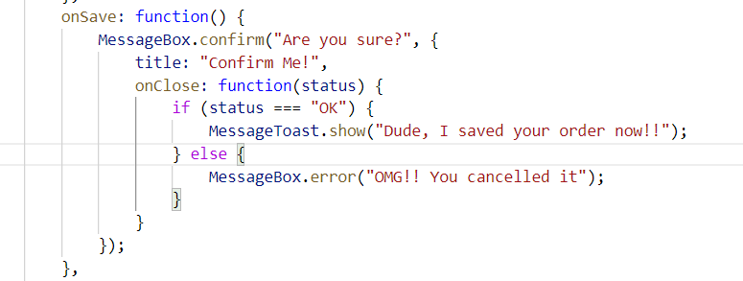
Message Dialog
A message dialog interrupts the user's workflow by blocking the current page and needs to be closed by the user.
Use a message dialog if the message is important and must be acknowledged by the user.
The easiest way of showing message dialog is to use the sap.m.MessageBox.

Slide 4
Types of MessageDialog
MessageStrip is a control that enables the embedding of application-related messages in the application.
A message toast is a small, non-disruptive popup for success or information messages that disappears automatically after a few seconds.
Method: sap.m.MessageToast.show()
MessageBox provides several functions:
show(), alert(), confirm(), error(), information(), success(), warning
MessageBox
MessageToast
MessageStrip

Slide 5

Exercise 1
In this exercise we can add MessageToast and MessageBox on save Button
View2.view.xml
View2.controller.js

Slide 6
Dropdowns in SAPUI5
There are different types of dropdowns in SAP UI5
These are used to select single or multiple values
A drop-down list for selecting and filtering values.
select only one item in a long list of options
ComboBox
Dropdowns
The user needs to select one or more options from a long list of options
The sap.m.Select control provides a list of items that allows users to select an item.
Select
Multi Combo Box

Slide 7

Exercise 2
Add dropdowns in City Section
1. View2.view.xml

Slide 9

Introduction to OData Services
OData Stands for Open Data Protocol, it is an OASIS standard to communicate to server using REST based service. It was acquired by Microsoft in 2012 and adopted by many companies to build REST services to expose data over internet HTTP/HTTPs protocol.
Funda Fox
Fiori cannot talk to FM, program, CDS views, …. Fiori only and only talk to OData service which is built on top of FM, ABAP code, CDS view.
OData is open data protocol, it is used to create REST based services, initially developed by the OASIS company later acquired by Microsoft and make open source.
REST – Representational State Transfer – also known as STATELESS Communication
OData was developed by Microsoft in 2007 and later they made it open source.
Presentation
Fiori
SAP_UI
http request
response
OData
Hana
Note: Fiori Only and Only Understand OData.

Slide 10
OData Architecture
Central HUB Scenario Embedded Scenario
Presentation Layer
SAPGUI/Browser
Presentation Layer
SAPGUI/Browser
Fiori Apps
[new]Fiori Frontend Server
Like a HUB/Switch
services
Embedded System (LOCAL)
Services, Reg.,Publish, Fiori Apps, Launchpad, Designer, Apps, Code, ABAP Code
OData services publish
Fiori launchpad
RFC(SM59)
Existing ECC/App Layer
Fiori Backend Server
SAP CRM
SAP PLM
Development of service code
SAP HCM
SAP SRM

Slide 11
Advantage and Disadvantage of Central HUB
Advantage
Disadvantage
Able to use Fiori – adapt innovation
We are able to connect now multiple such backend
Separation of duties
More security
Upgrade free
It is Costly
Confusion
Manage security double
Functionality is distributed
Redundancy
Latency

Slide 12
Advantage and Disadvantage of Embedded
Advantage
Disadvantage
Low Cost
Confusion is gone
No need to create RFC – LOCAL
Setup is much easier
Security is at one place
Low latency
Still use this system as a HUB in future
We must be on SAP NetWeaver 7.4
If the system is down, both fiori and classical functionality will not work.

Slide 13
OData Basic
When we call a service, it loads a service document, a service document includes multiple OData Entity Sets inside. Each service also has a metadata document which explains about properties inside of each entity set.
Service Document (Collection of Entity Sets) – 1 Entity Set = 1 DB Table
https://services.odata.org/V2/(S(gte5obp1xr5gdvcqffzwbrwq))/OData/OData.svc/
Service metadata (/$metadata) – all the entity types and entity sets
Entity Type is the blue print of data set, entity set is the access point of actual data
https://services.odata.org/V2/(S(gte5obp1xr5gdvcqffzwbrwq))/OData/OData.svc/$metadata
Access Multiple Records of an Entity Set (SELECT * FROM dB table)
https://services.odata.org/V2/(S(gte5obp1xr5gdvcqffzwbrwq))/OData/OData.svc/Products?$format=json

Slide 14

Format of an OData URL
http://stcfin.st.com:8021/sap/opu/odata/IWBEP/GWSAMPLE_BASIC/ProductSet?$format=json
http(s)://hostname:port/sap/opu/odata/sap/SERVICENAME_SRV/ENTITYSET?p1=val&p2=val
Protocol
Address & Port
Path prefix
Service Name
End Point Access Data
Query Options

Slide 16
Client Side Query with OData
Sets the page size of results.
02
$top
Indexes into a result set. Also used by some APIs to implement paging and can be used together with $top to manually page results.
Returns the results in the specified media format.
01
03
$format
$skip
ODATA Query
06
04
Retrieves related resources.
Filters properties (columns).
$expand
$select
05
$filter
Filters results (rows).

Slide 17
TCodes and Service
SEGW – SAP Service Gateway Builder
/n/IWFND/MAINT_SERVICE – Register the service
/n/IWFND/GW_CLIENT – gateway client – test locally
/n/IWFND/ERROR_LOG – Check errors, troubleshoot
EPM – Enterprise procurement model – Demo data model given by SAP for Training and demonstration.
ITeIO
SO
Customers
PO
Suppliers
Invoices
Stock

Slide 18

End of Day 13

Slide 19

Questions

Slide 20

Anubhav Oberoy

Slide 21


We’re committed to empower you to be
Most Desirable Resource
through powerful training solutions.
We build the workforce of the future.
250+
Corporate Clients
30,000+
Learners Trained
25000+
Learners Placed
FREE WEBINARS
Sign up for free webinars with industry experts every fortnight!
Enroll Now!
Contact us today!
https://anubhavtrainings.com/

Slide 22




More from AnubhavTrainings.com

